Slide 1

Daily Activities & Personal Finance Tracker
Presented by:
Jenish Limbu
Kiran Jethara

Slide 2
Introduction
The “Daily Activities & Personal Finance Tracker” is a system which helps to view and analyze the daily activities and manage incomes/expenses of an individual. It serves as a valuable tool in this regard, helping individuals to plan, monitor, and optimize their daily tasks while also keeping a close eye on their financial health. In short, this system is designed to record and analyze time and money of a user.

Slide 3
Problem Statement
Unmanaged Tasks
There are a lot of problems while managing all the daily and occasional tasks.
Unplanned/Unmanaged Personal Finances
While spending or managing money, many people don’t realize their overspending in certain occasional outflows.

Slide 4
Objective
The objectives of “Daily Activities & Personal Finance Tracker” are: ➢ To provide users with a comprehensive view and tracking system for their daily activities and personal finance-related data. ➢ To help users in maintaining disciplined habits.

Slide 5
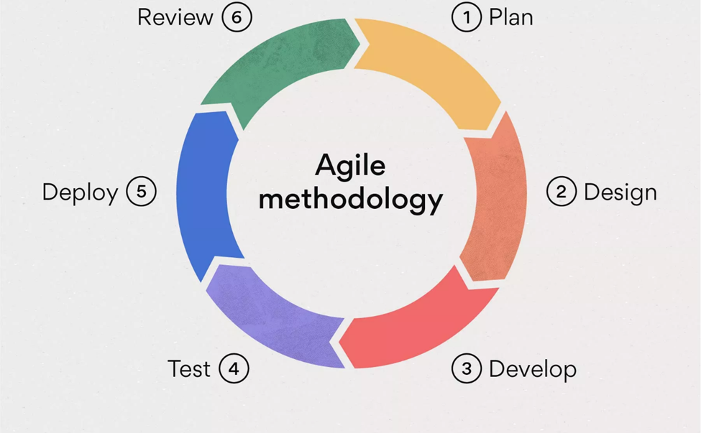
Development Methodology

Slide 6
Requirement Analysis
Functional Requirement
Non-Functional Requirement

Slide 7
Functional Requirement 1. Multi-user. 2. Tasks Summary/Conclusion. 3. Income/Expenses comparison. 4. Budget Allocation For Expenses.

Slide 8
Non-Functional Requirements
Availability
Flexibility
Security
Reliability

Slide 9
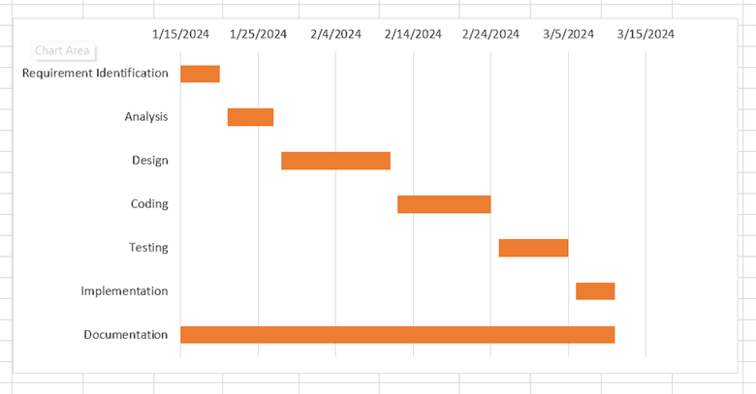
Gantt Chart

Slide 10
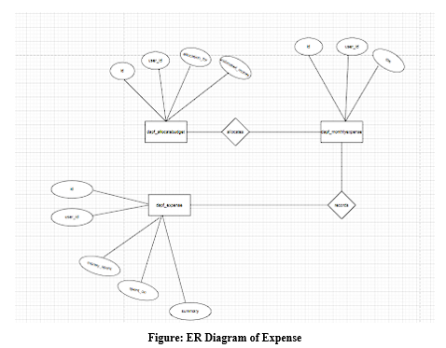
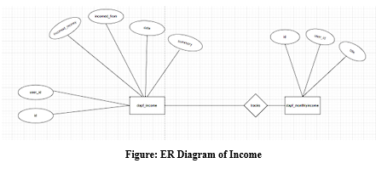
ER-Diagram

Slide 11
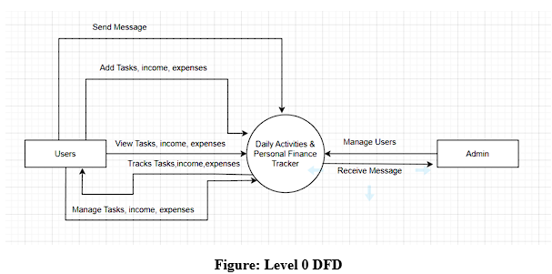
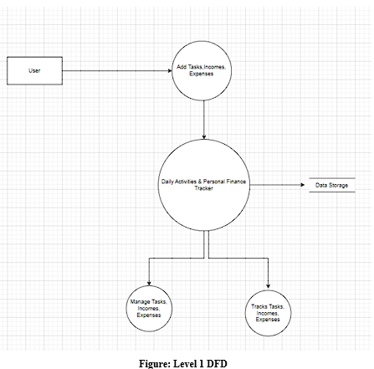
DFD

Slide 12
Implementation Tools 1. Front-End Tools I . HTML II . CSS III . JavaScript 2. Back-End Tools I . Php 3. Database I . MySQL 4. Documentation Tools I . MS PowerPoint II . MS Word III . Draw.io

Slide 13
Challenges Faced
XAMPP Server Crash
Limited Similar Systems for Research
Frequently Changing Ideas

Slide 14
Conclusion
In conclusion, the "Daily Activities & Personal Finance Tracker" system is a comprehensive tool designed to empower individuals by providing insights into their daily routines and financial habits. By facilitating the recording and analysis of time and money management, this system aims to help users make informed decisions, optimize their tasks, and enhance their overall well-being.

Slide 15
Thank You

